Slide 1
Sentiment of the Israel-Palestine Conflict
Group 7: Quan Ly, Michelle Odnert, Kaiden Ong,
Jonathan Bustamante Osorio, Stephanie Wang
Notes:
Michelle

Slide 2
Agenda
01
Motivation
06
Experiments
02
Problem Definition
07
Results
03
Related Work
08
Discussion
04
Data
09
Limitations & Future Work
05
Approach
10
Conclusion

Slide 3
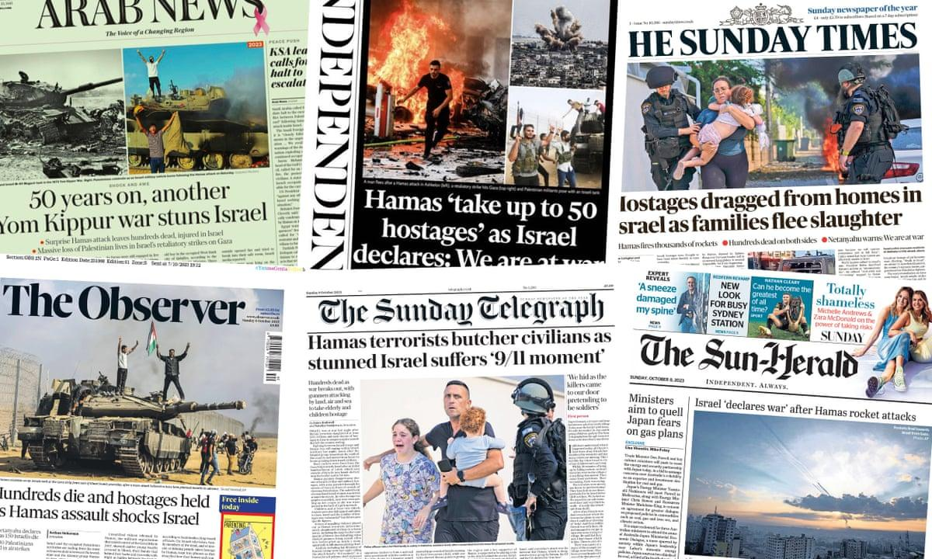
Motivation
Apply what we have learned to a relevant, real-world topic
Capture a sense of public sentiment towards an extremely complex and polarizing issue
Notes:
Michelle

Slide 4
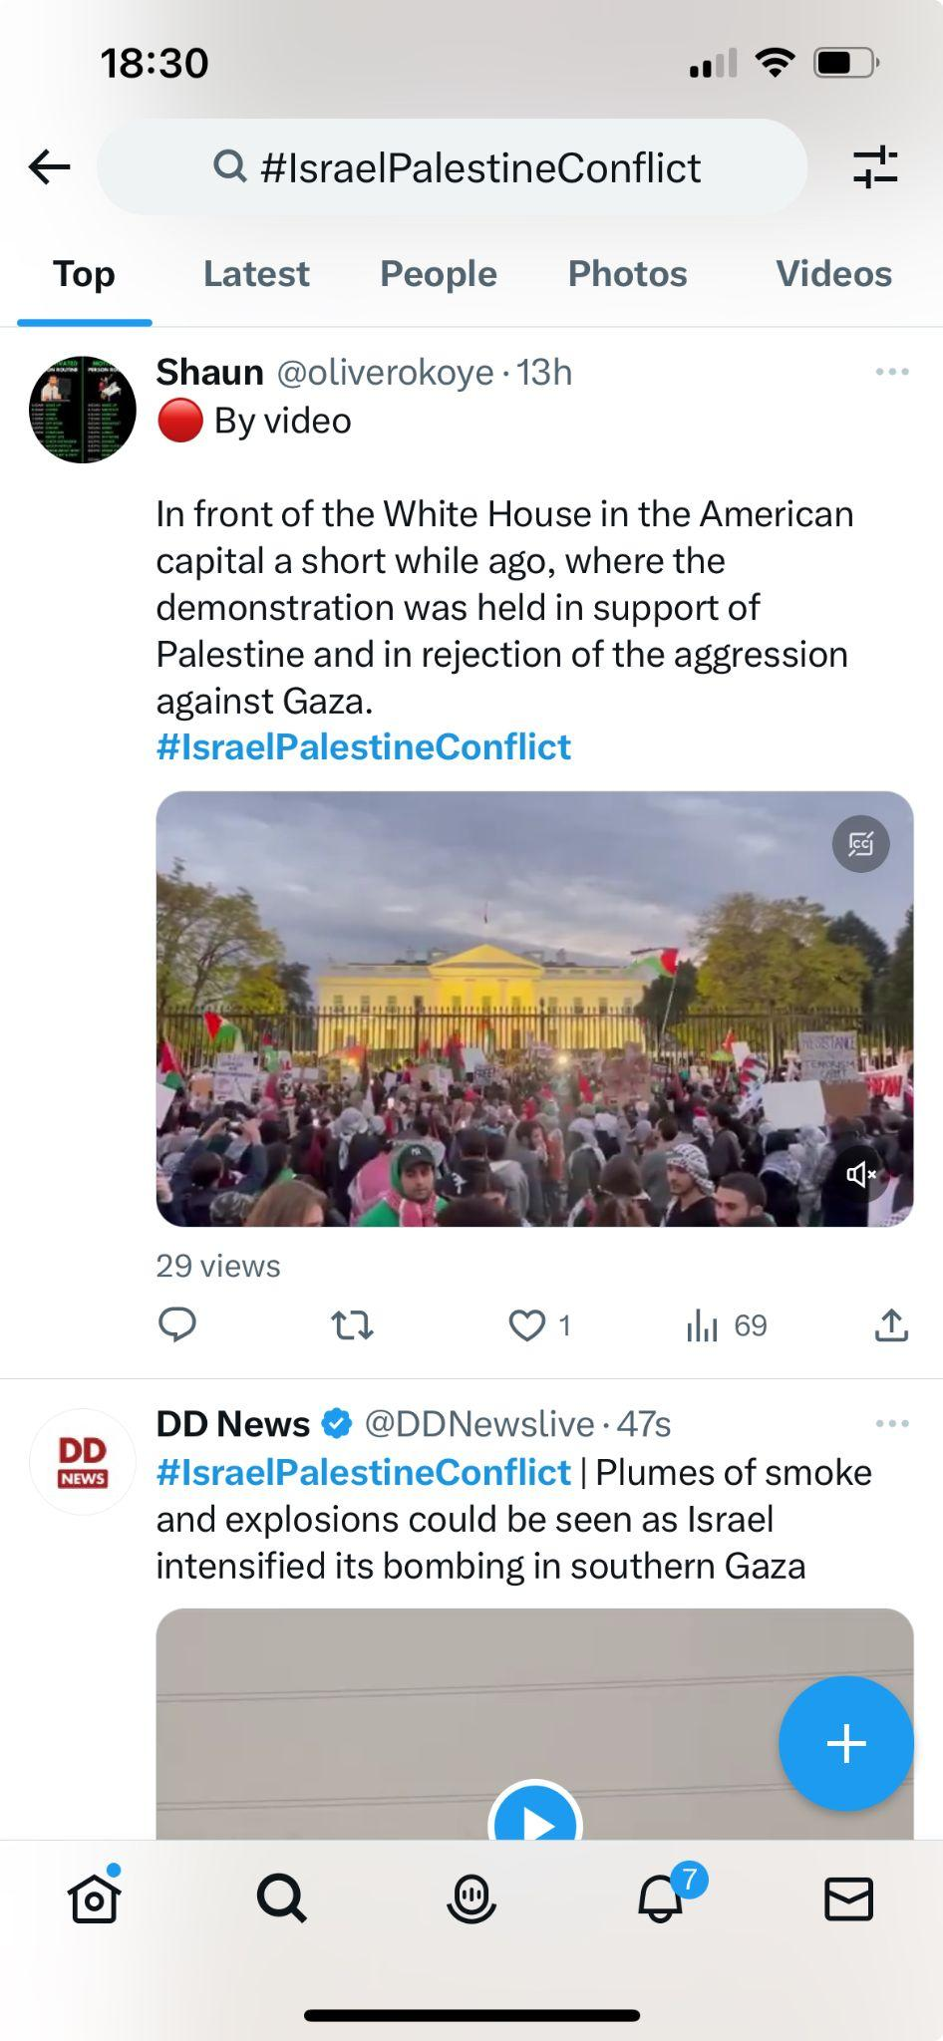
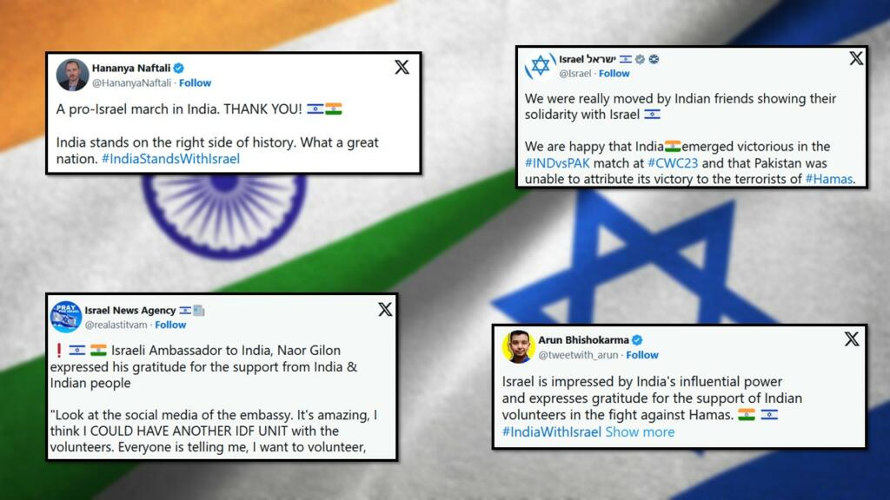
Question:
What is the current sentiment of English-speaking Twitter users toward the Israel Palestine conflict?
Notes:
Michelle

Slide 5


Related Work
Twitter Sentiment Analysis about ChatGPT
Conducted from December 2022 to January 2023
Identified main topics and sentiments of early users
(Huang, 2023)
Sentiment Analysis of Twitter
Focuses on trends of tweet languages and volumes
Classifies tweets into positive, strongly positive, weakly positive, negative, strongly negative, weakly negative, and neutral
(Sahayak et al., 2015)
Sentiment Analysis of Political Tweets for Israel using Machine Learning
Focused on analyzing tweets about Israel (e.g. #IsraelUnderAttack, #IStandWithIsrael, #WeStandWithIsrael, #IsraelPalestineConflict)
Data worked upon is dated May 2021
Utilized techniques like SVM, DT, and NB to train model
Results: NB model obtained highest accuracy of 93.21%
(Gangwar et al., 2022)
Notes:
Stephanie

Slide 6
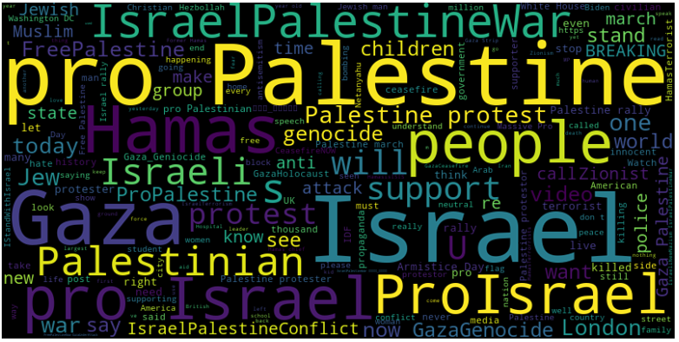
1,360 Tweets
Scraped using the Octoparse API
Notes:
Jonny
During the data collection process, we scraped 1,360 Tweets from twitter that had any content relating to Israel, Palestine, conflict, and other related words
We scraped it using the Octoparse API from Oct 7, the day that Hamas attacked, to the middle of November, when we started our analysis.
This word cloud shows the recurring words that came up within each tweet, as you can see “pro Palestine”, “Israel”, and “Gaza” are the biggest words in the bubble

Slide 7
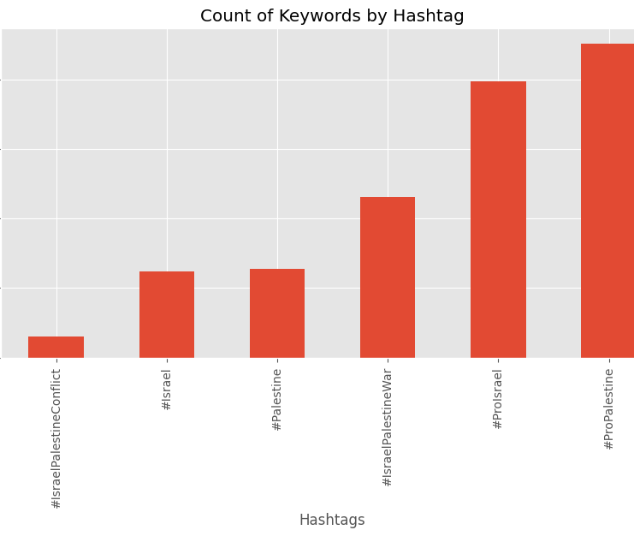
Breakdown of Tweets by Hashtag:
#ProPalestine = 451
#ProIsrael = 397
#IsraelPalestineWar = 231
#Palestine = 127
#Israel = 124
#IsraelPalestineConflict = 30
Notes:
Jonny
In looking at the hashtags directly,
we found that #ProPalestine came up to be 451
ProIsrael at 397
Then IsraelPalestineWar at 231

Slide 8
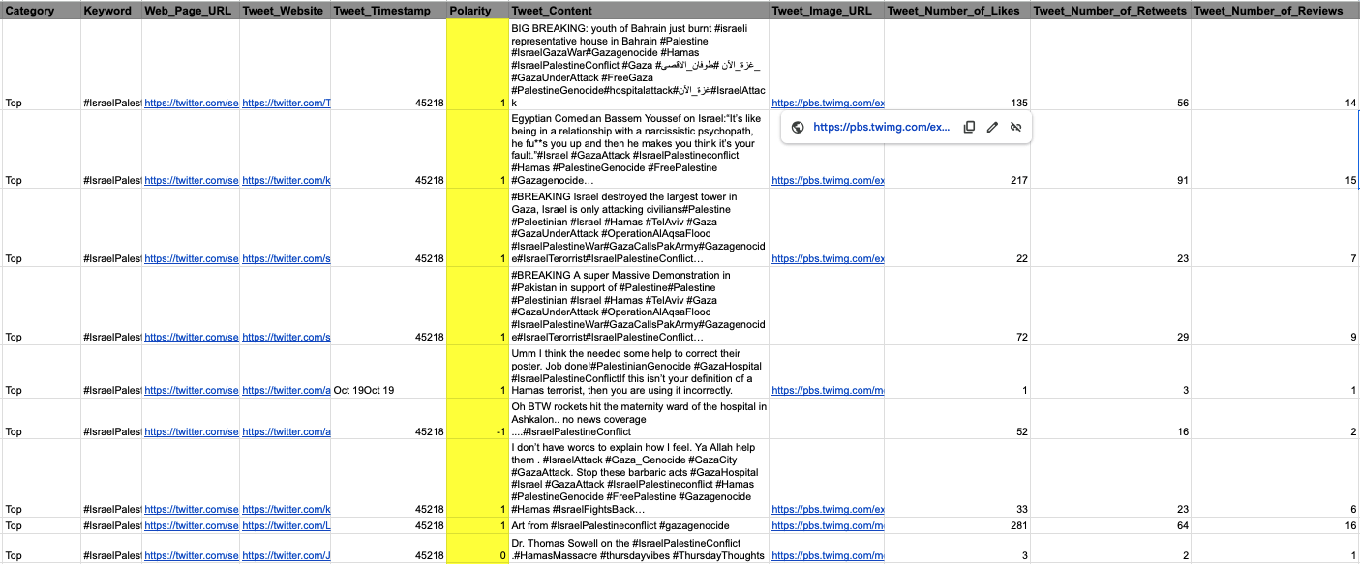
Classified Tweets by Hand
-1
0
1
Supporting Israel
Neutral/News Report
Supporting Palestine
Notes:
Michelle

Slide 9
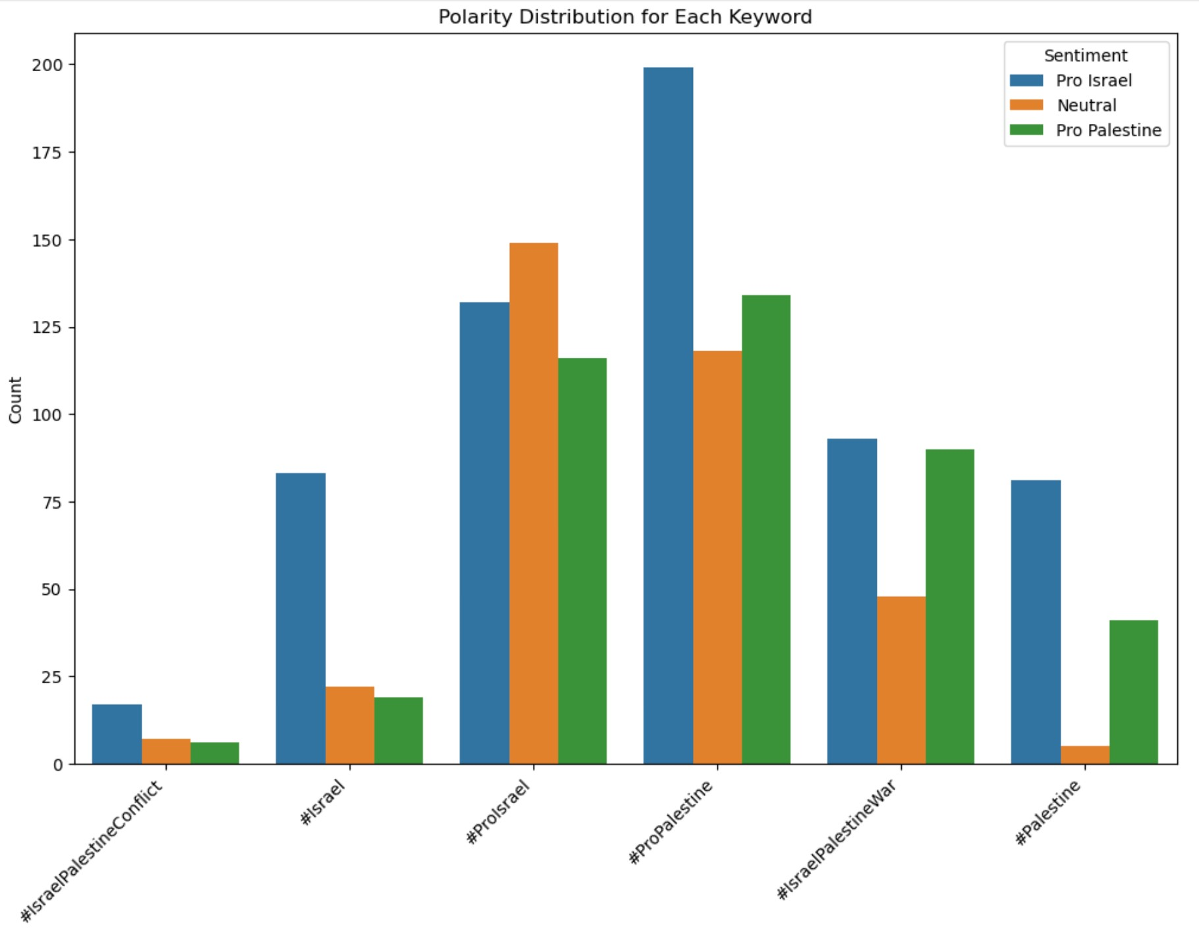
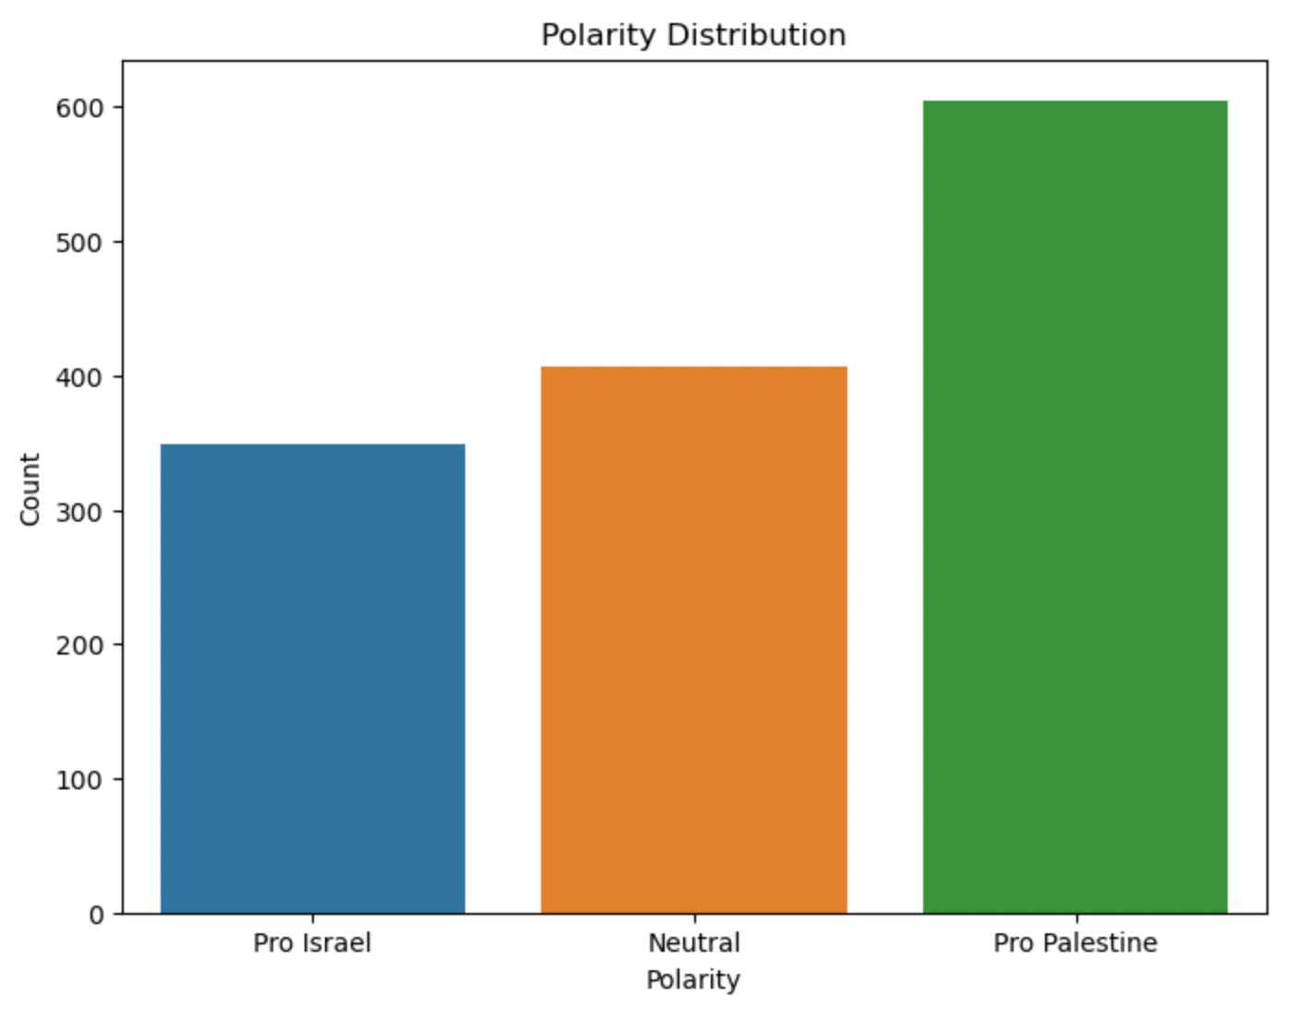
Polarity in General and Per Keyword
Notes:
Jonny
Based on the manual sentiment analysis, as previously stated by Michelle, we analyzed the polarity sentiment in general versus per keyword.
We found that the highest sentiment count was Pro Palestine at 600, followed by Neutral at 410, then Pro Israel at 350.
As for the polarity for each keyword, we found that
#ProPalestine had the highest polarity for sentiments ProIsrael and ProPalestine
And #ProIsrael had the highest sentiment for Neutral

Slide 10
A Methodological Approach To Sentiment Analysis
Using ML Models
Which Model is Best?
04
Decision Trees
Support Vector Machines
Naive Bayes
Comparing models with metrics such as precision, accuracy, etc
Train, Test, Split
03
Use our data and new “Polarity” feature to train and test our models
Feature Engineering
02
Manually categorizing data into Pro-Israel, neutral & Pro-Palestine
Vader and Roberta
01
Models to determine overall sentiment of Twitter users
Notes:
Kaiden
Collecting data (last few slides)
Using ML models
Feature engineering
Removing na, dup (sentiment)
Tfidf (vectorization), textblob (lemmatization), emoji translation, adding polarity
All models used the same preprocessed data to ensure consistency
Train models
Metrics (Accuracy, precision, false +-)

Slide 11
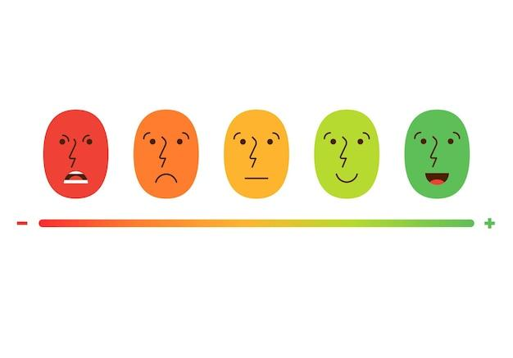

Sentiment Analysis
Vader Model
Roberta Model
Model Analysis
Decision Trees
SVMs
Naive Bayes
Notes:
Kaiden
VADER and Roberta give each tweet a sentiment score, -1 and 1
Plan to use this data to calculate overall sentiment
These models give us the opportunity to test uncategorized data

Slide 12
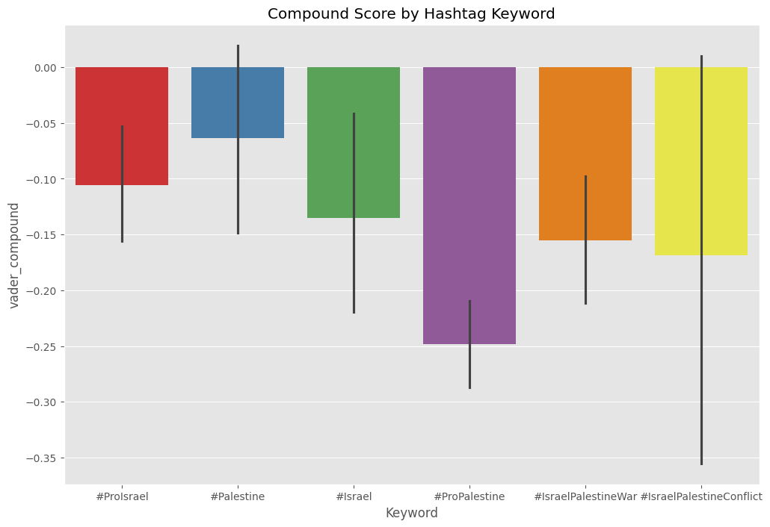
Vader Model
Notes:
Quan

Slide 13
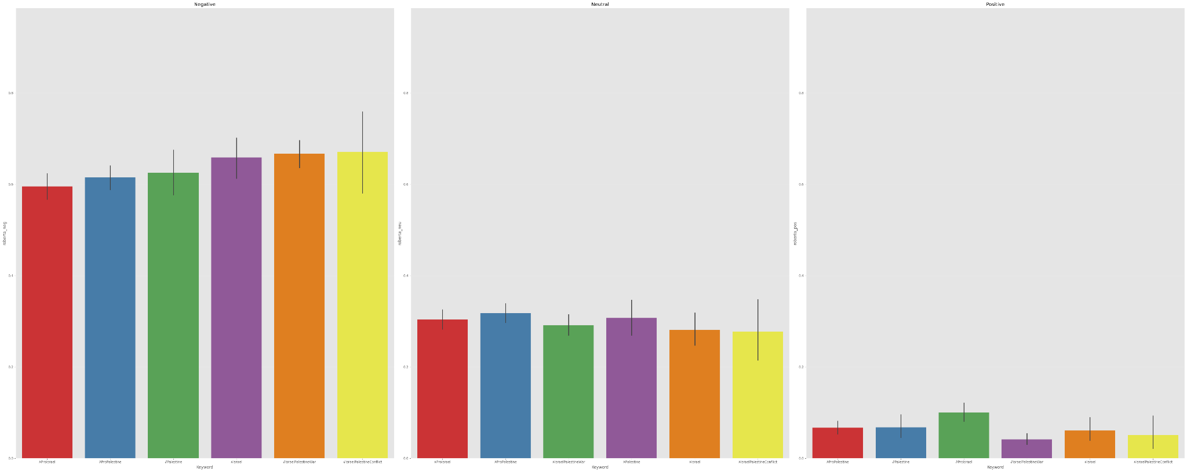
Roberta Model
Notes:
Quan

Slide 14
Vader VS Roberta
Sentiment Scoring Ranges by Category
Negative | Neutral | Positive
~[0.09 - 0.13] (V) ~[0.59 - 0.67] (R) | ~[0.79 - 0.84] (V) ~[0.27 - 0.32] (R) | ~[0.05 - 0.09] (V) ~[0.04 - 0.10] (R)
Notes:
Quan

Slide 15
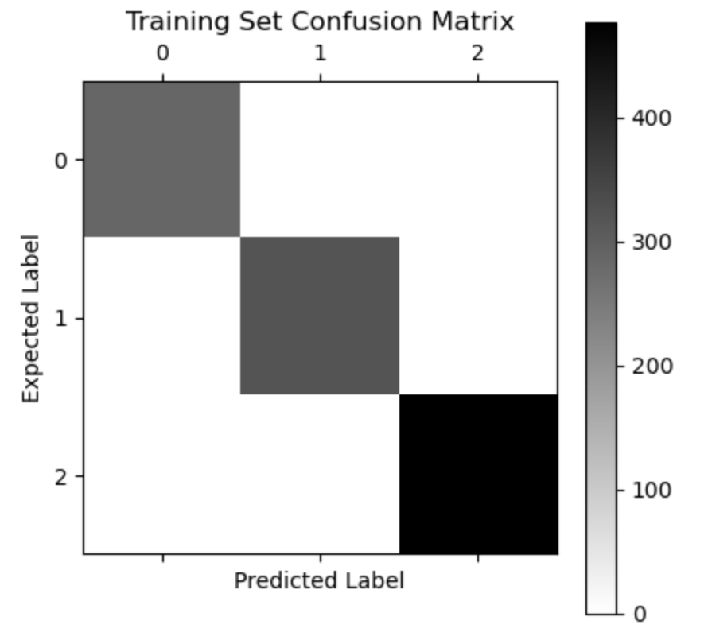
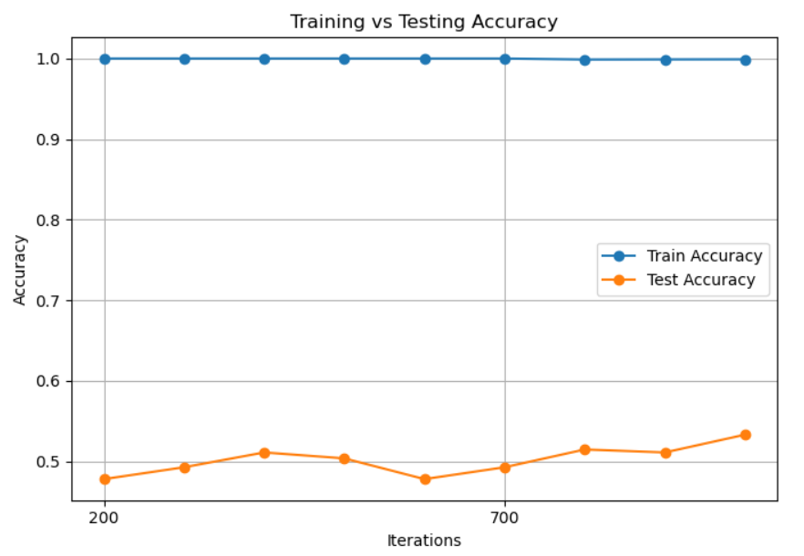
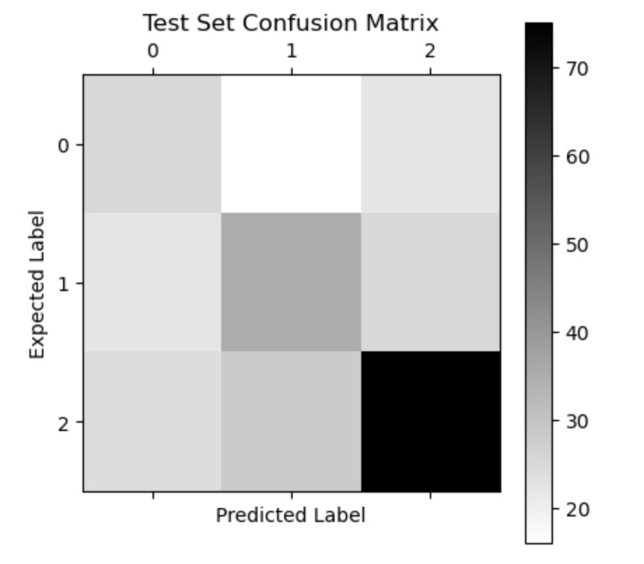
Decision Tree
Notes:
Stephanie
The Decision Tree achieved a high level performance on the training set, demonstrating a high level of accuracy and precision.
The numbers coming out to be around 99%.
However, its performance dropped when applied to the test set, indicating an overfitting to the training data.
The accuracy numbers for the test set came out around to be 49.6%, indicating that the model's performance drops on new, unseen data.
The confusion matrix for the training set shows no misclassifications while the confusion matrix for the test set shows misclassifications, particularly in predicting negative and neutral sentiments.

Slide 16
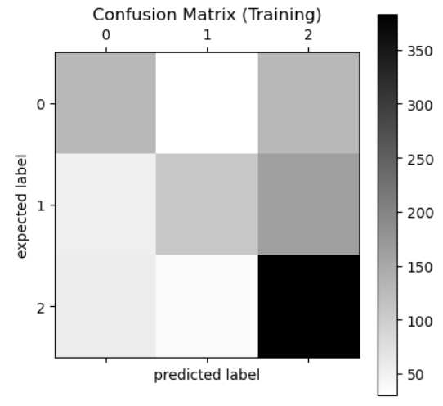
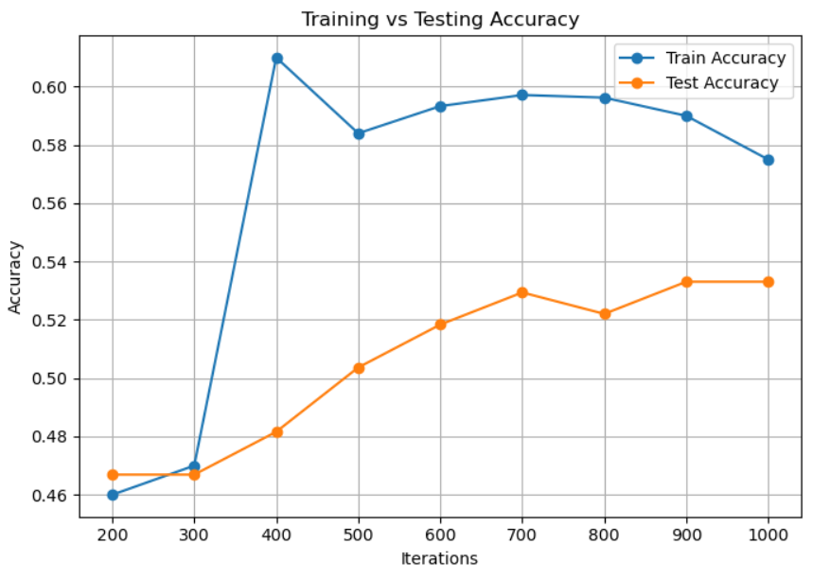
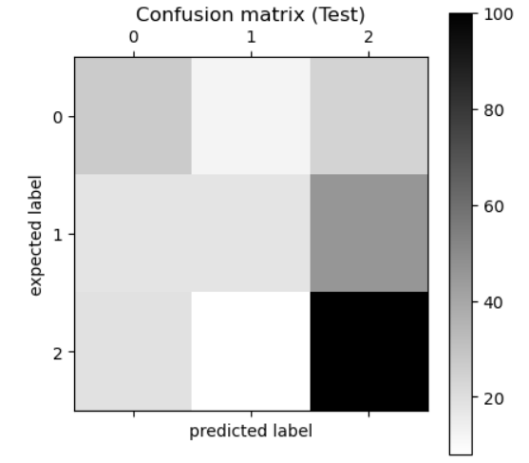
SVM
Notes:
Kaiden
Quite accurately categorizes neutral, whereas false +- on other 2.
Closer train and test accuracies

Slide 17
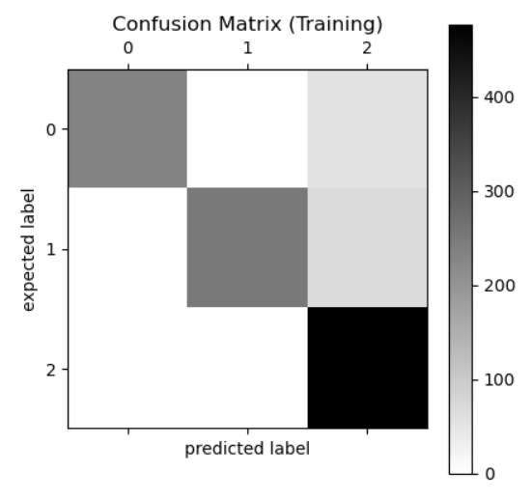
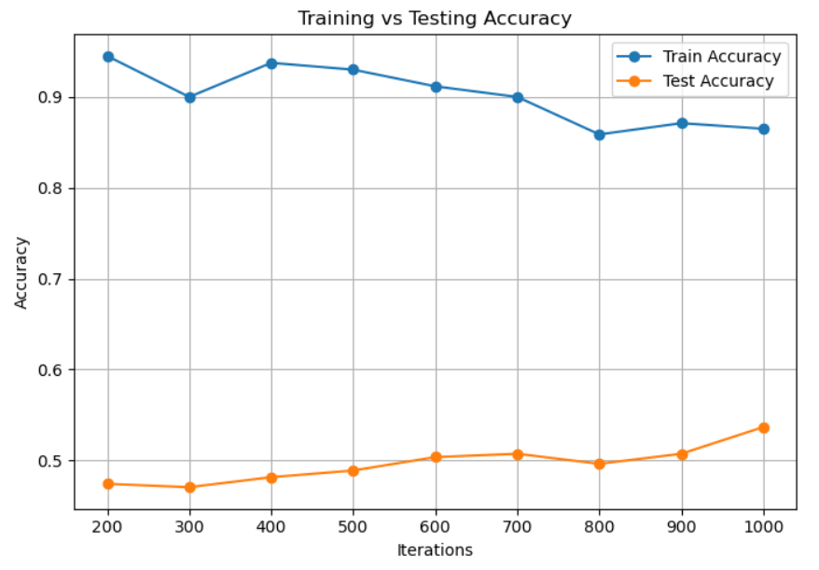
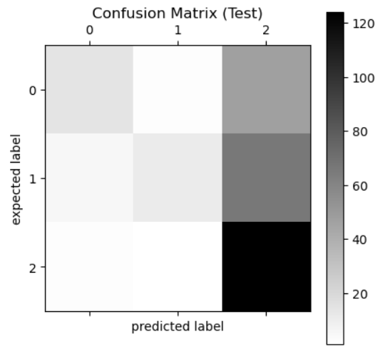
Naive Bayes
Notes:
Michelle

Slide 18
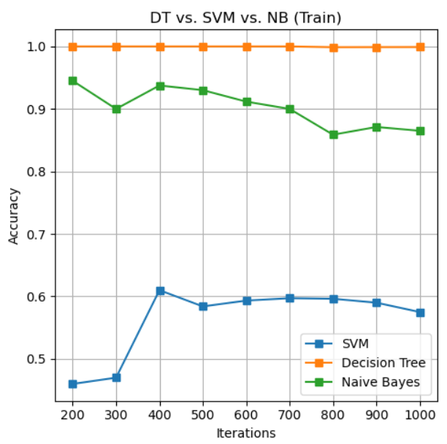
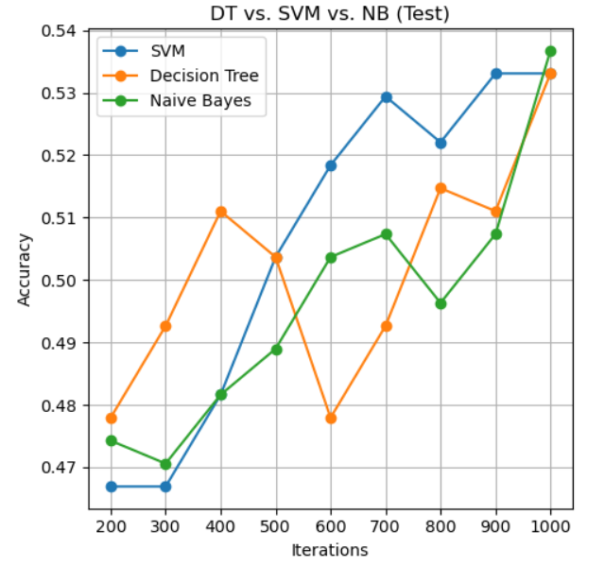
Comparing Accuracies in Training and Testing
Notes:
Kaiden
SVM overfitting less
Generally trending upwards, more data would be better
Better than random because 3 categories

Slide 19
Limitations
Future Work
Data and Approach
Data
Tweets that only make sense when you view the media (images/videos) attached
Tweets that quote other tweets (conflicting stances)
Language nuances and cultural biases
Looking at popular tweets may oversimplify the dynamic and public opinion
Inconsistency when manually classifying (some tweets are ambiguous)
Expanding dataset
Scraping tweets from more hashtags to capture wider range
Models
Fine-tune machine learning models to improve accuracy
Add additional sentiment intensity (strongly pro, weakly pro, etc.) levels beyond the three we have currently
Notes:
Stephanie

Slide 20
Key Takeaways and Contributions
Data and Approach
No matter the distribution, the general consensus of the tweets were negative
Machine Learning
Tendency to overfit
Otherwise better than random at determining sentiment
Notes:
Jonny
Even with the limitations, no matter what side you are on, the general sentiment on twitter is spreading negativity, which should be taken note of.
As for Machine Learning process, we found that it had a tendency to overfit, but otherwise were better than random selection at determining sentiment.

Slide 21
Thank you!
Questions?

Slide 22
References
Gangwar, A., & Mehta, T. (2022). Sentiment Analysis of Political Tweets for Israel using Machine Learning.
Huang, H. (2023, May). Twitter Sentiment Analysis about ChatGPT. GitHub. https://github.com/hxycorn/Twitter-Sentiment-Analysis-about-ChatGPT
Sahayak, V., Shete, V., & Pathan, A. (2015, January). Sentiment Analysis on Twitter Data. International Journal of Innovative Research in Advanced Engineering (IJIRAE), 2(1).

